Slide 1


Self-Driving Simulation with Computer Vision and Carla
Younghoon Choi
Professor Izmirli
Notes:
My research on self driving simulation with computer vision and Carla

Slide 2


Carla
An open-source simulator for autonomous driving
Developed to support training and validation of the autonomous driving system.
Provides different environmental conditions such as weather, map and etc…
Notes:
Carla is a 3d environment platform i used to train and test my data.
It provides different environment such as weather
Powered by the unreal engine which can be found in high-graphic video games these days

Slide 3
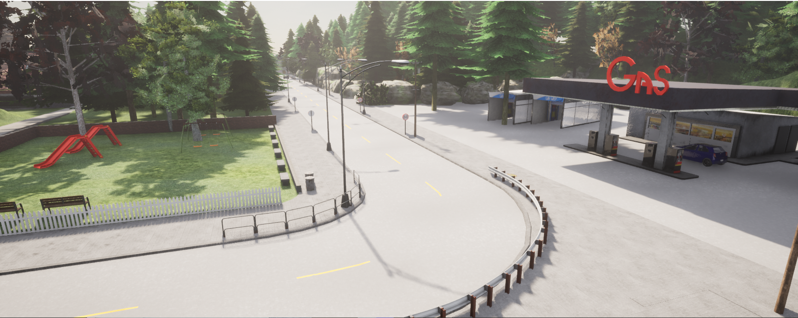
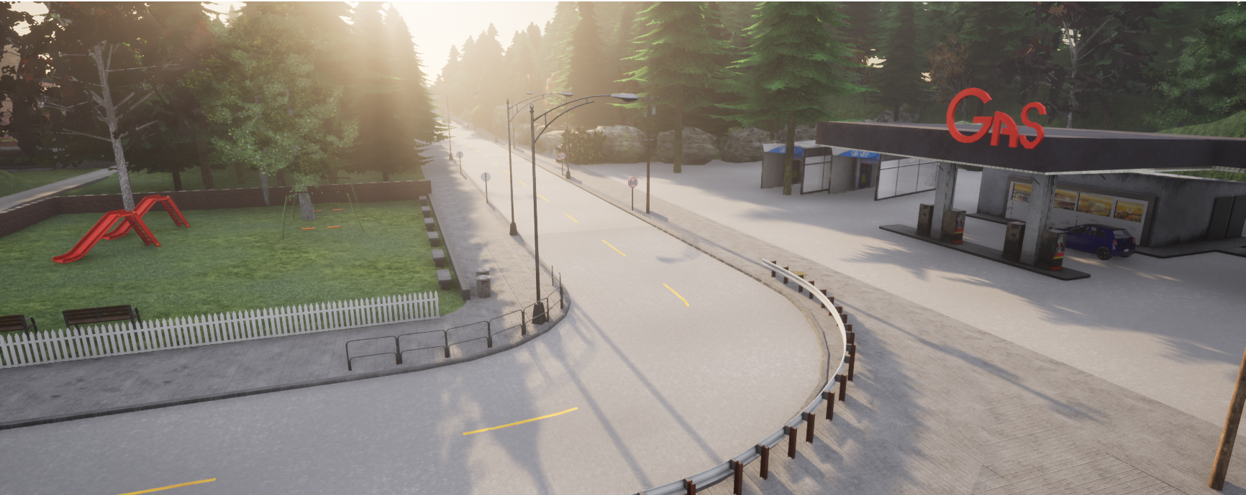
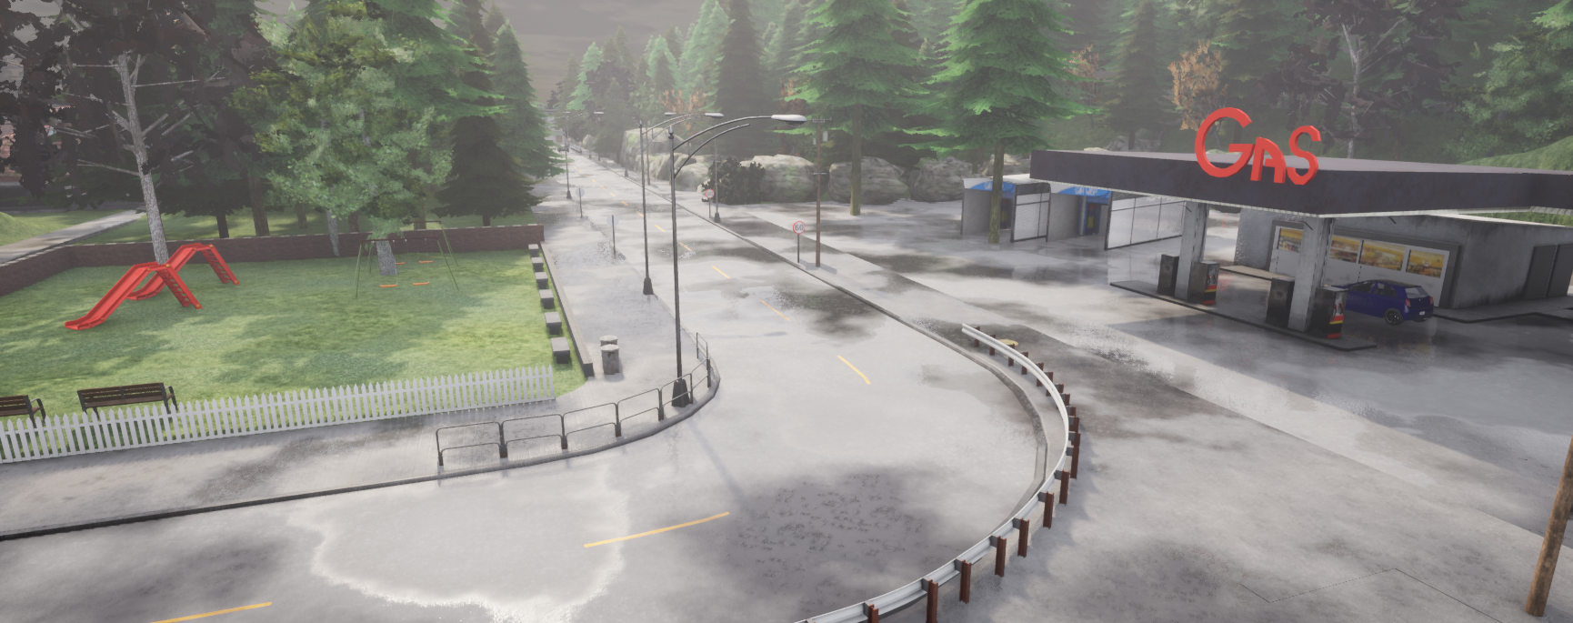
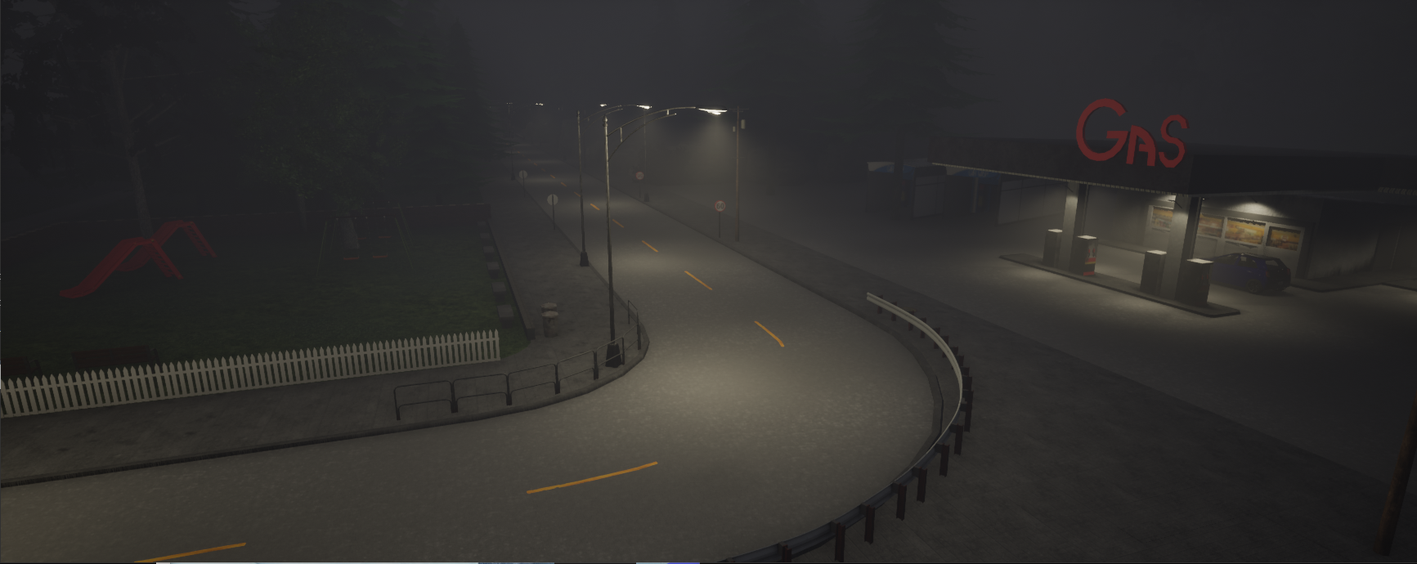
Weather conditions
Clear Noon
Clear Sunset
Mid Rainy Noon
Cloudy Evening

Slide 4

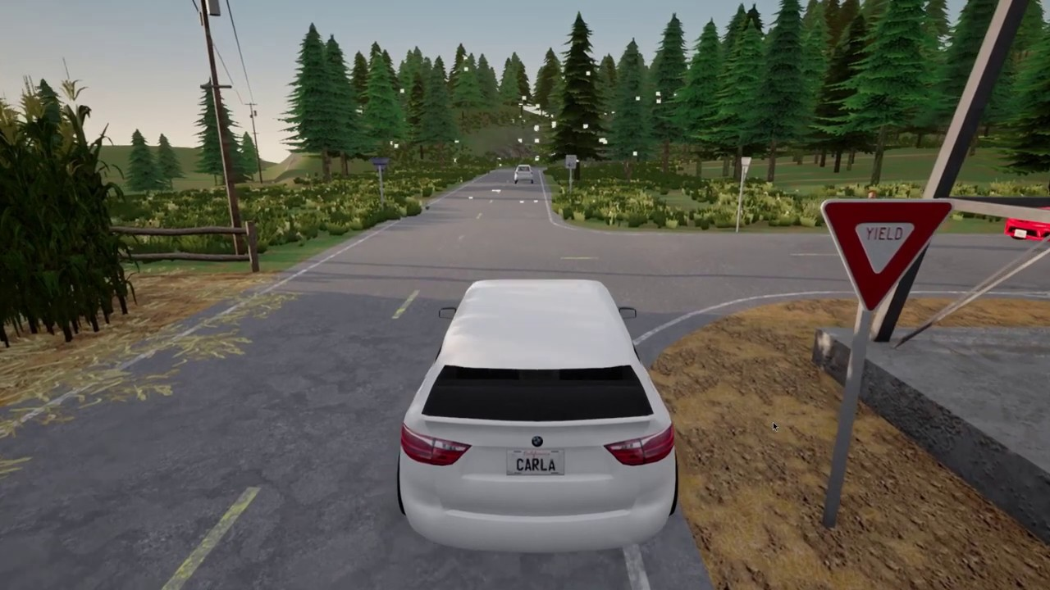
Vehicle in Carla
Camera
Free of position
Multiple cameras can be activated
Control
Throttle
Steer
Brake
Sensors
Collisions (lanes, and objects)
Ground truth (traffic signs and lights)
Notes:
Could add values to those control
Ground truth for the sensors!

Slide 5
Goal of this Research
Achieve autonomous driving through simulation
Computer Vision
Vehicle Control
Routing
Create my own dataset using the simulation
Train and test different learning methods
Compare results from different conditions of the simulation

Slide 6
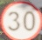
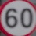
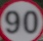
Dataset
Self-collected data from the Carla Simulation
Training Data
Total Images: 904
30MPH: 446
60MPH: 282
90MPH: 176
4 Weather Conditions:
MidRainyNoon
Cloudy Evening
Clear Sunset
Clear Noon
Notes:
These conditions were chosen to test how my model performs in each of those conditions

Slide 7
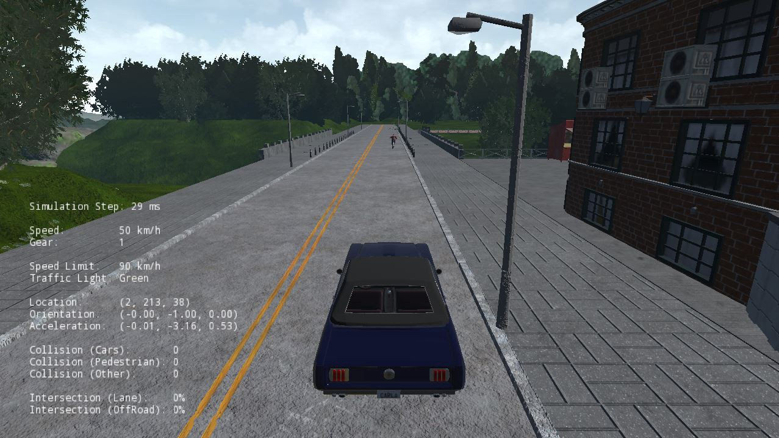
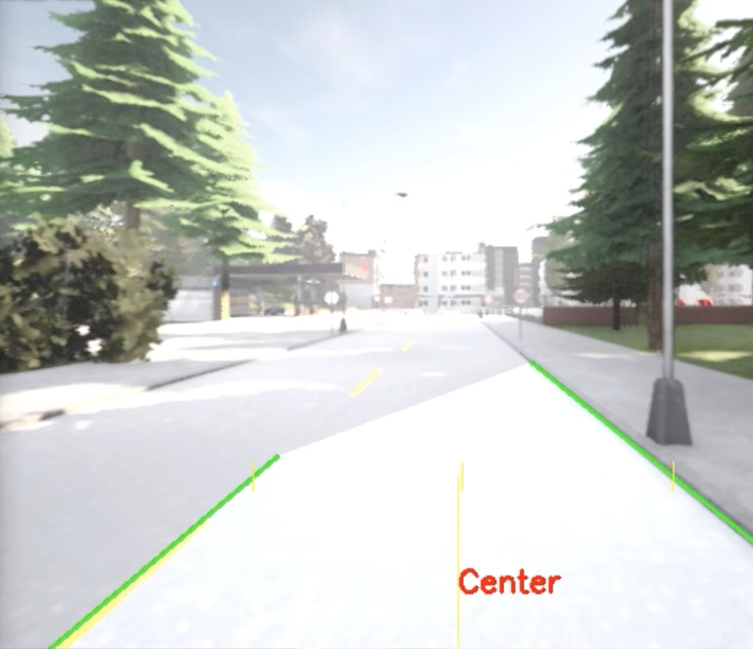

Perspective
Dashcam perspective
Notes:
All the images used for image processing were from dashcam view

Slide 8
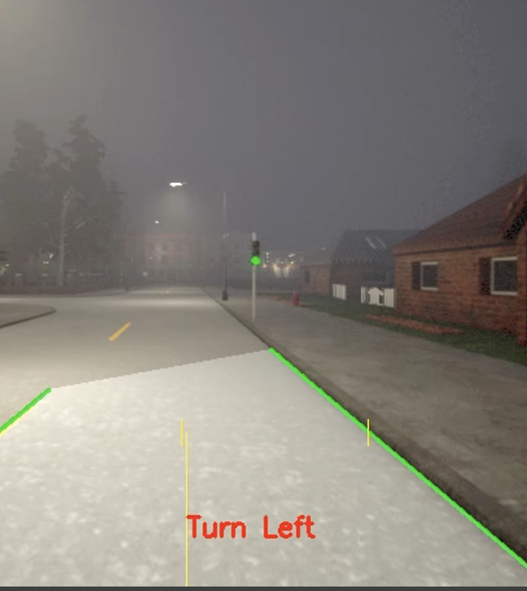
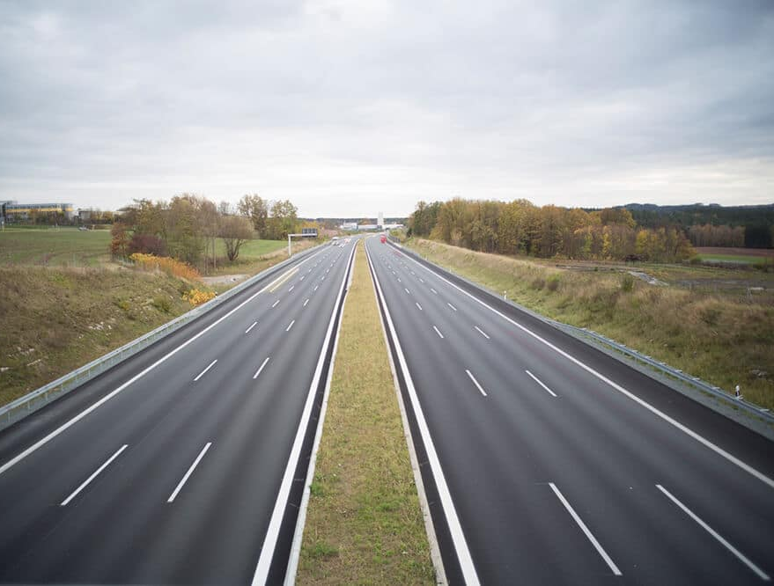
Lane Detection
Detect the lane using Hough line detection.
Compare the center point of the vehicle to the center point of the lane detected then steer as needed

Slide 9
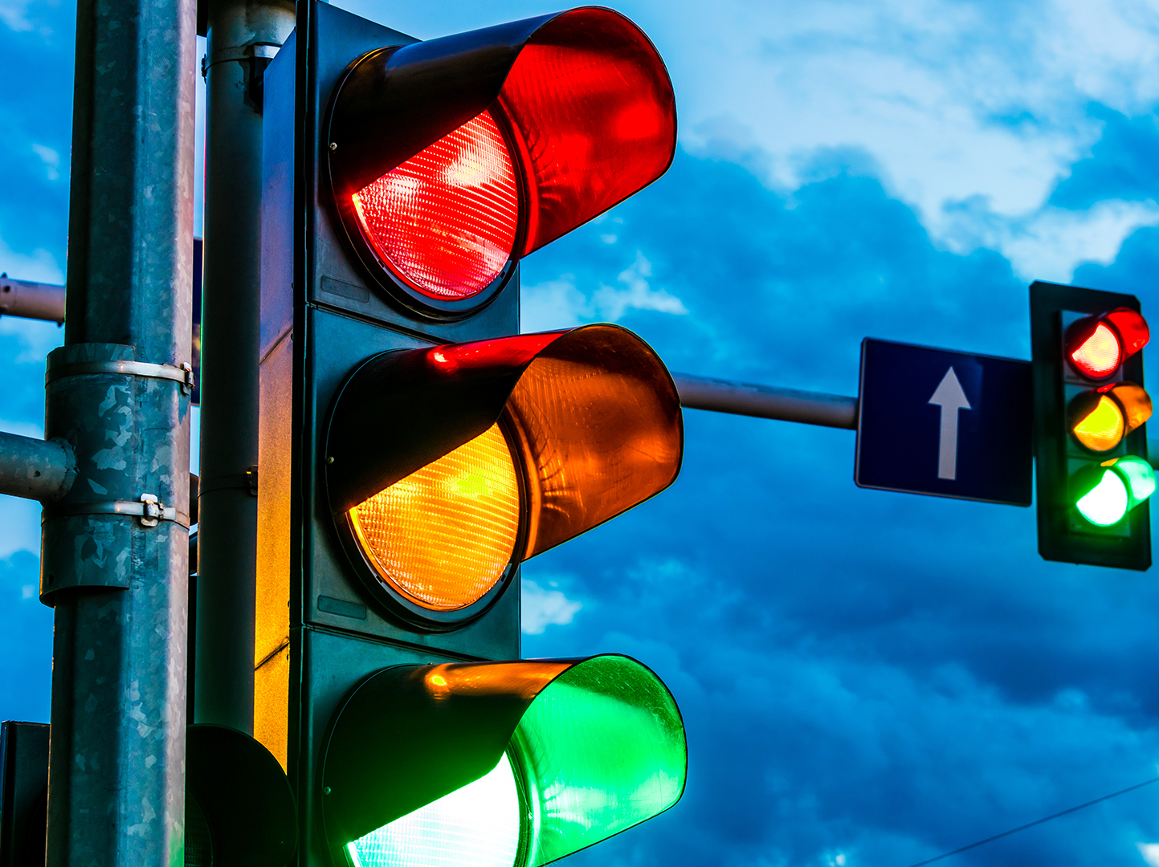
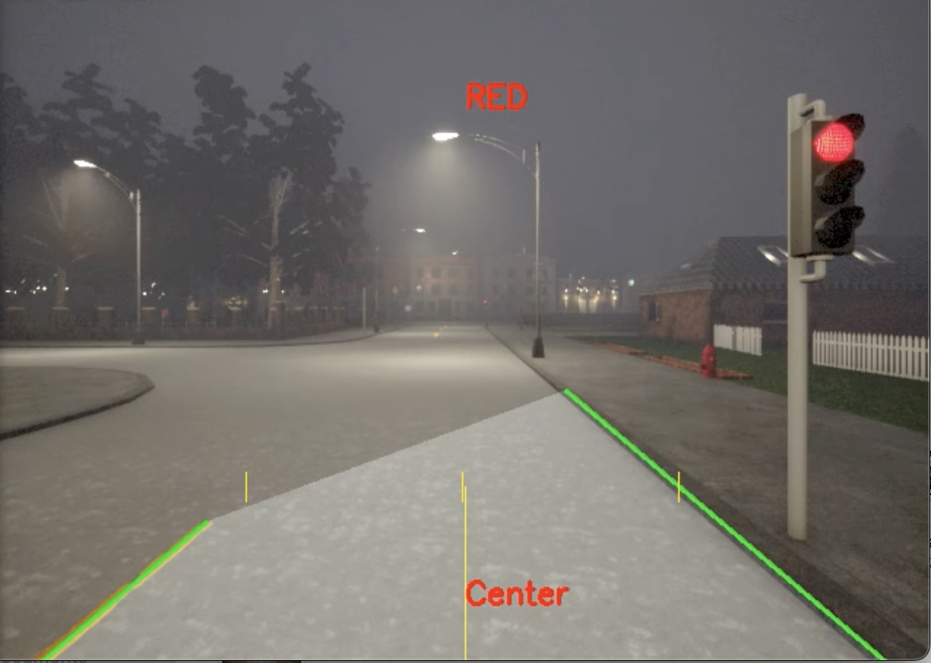
Traffic light
Hough Circle(place holder)
Detect any circular object in the area where lights are
HSV Value
Check the HSV value of the area
Detect red or green

Slide 10
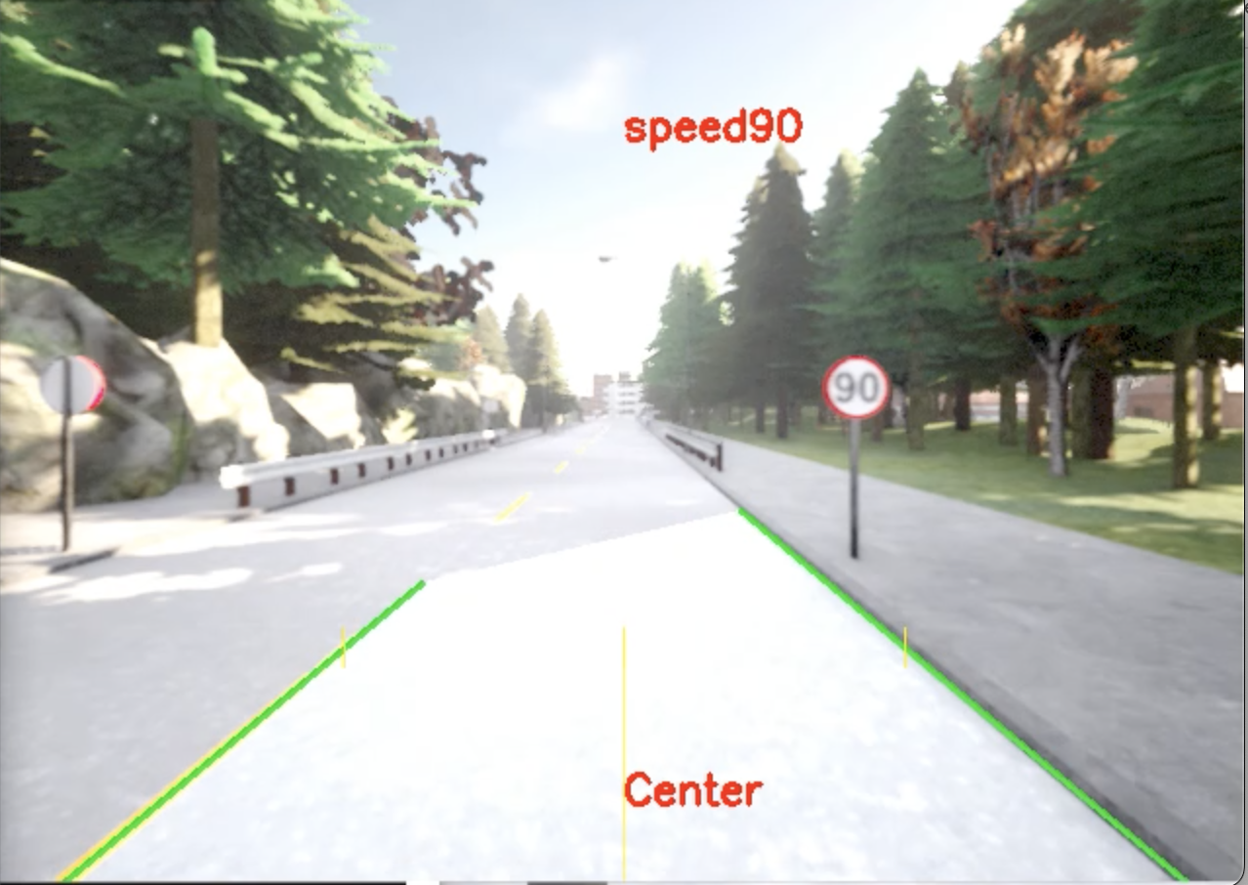
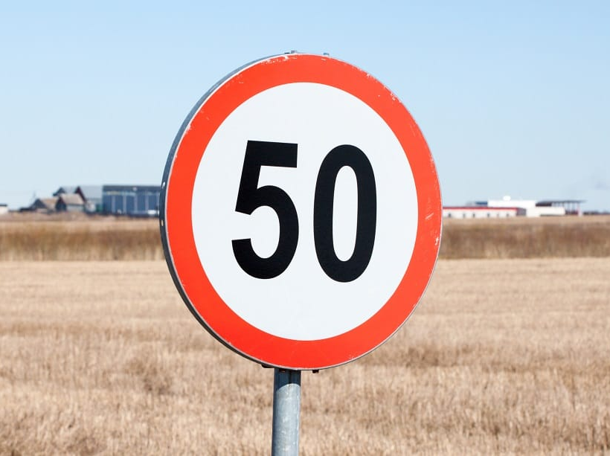
Speed Sign Classification
Hough Circle
Detect any circular objects and crop the image
Template Matching
Filter out images if the correlation is lower than the threshold to templates of signs
SVM
Grid Search
Compare the image to the trained model and classify the sign
Notes:
Grid search has linear kernel

Slide 11
Results
Traffic lights
100% when detected
Speed Signs
(150 test images)
Total Accuracy
92.67%139/150
30 MPH
60MPH
90MPH
90% (45 out of 50)
96% (48 out of 50)
92% (46 out of 50)
Notes:
Which caused in clear sunset where the signs were not as visible

Slide 12
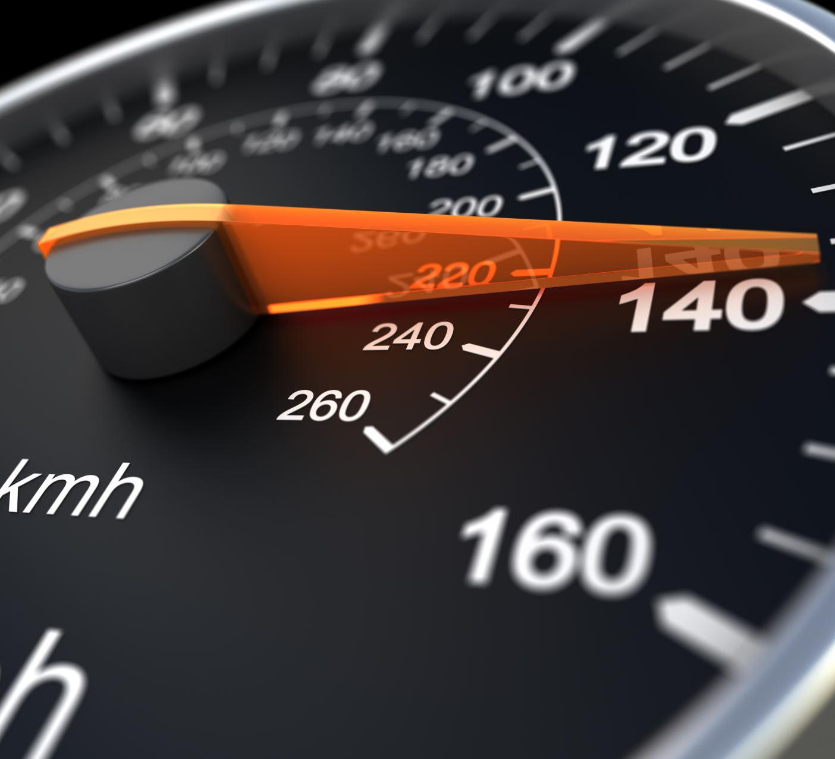
Vehicle Control
Closed-loop control
Simulation of real-time operation
Based on lane detection, issue vehicle control signals
The controller tries to match the center point of the dashcam and the center point of the lane
Provide sharper steer if the distance of the two center points is greater over a threshold
Notes:
vehicles in closed loop control which is simulation of real time operation
Every frame has cv

Slide 13
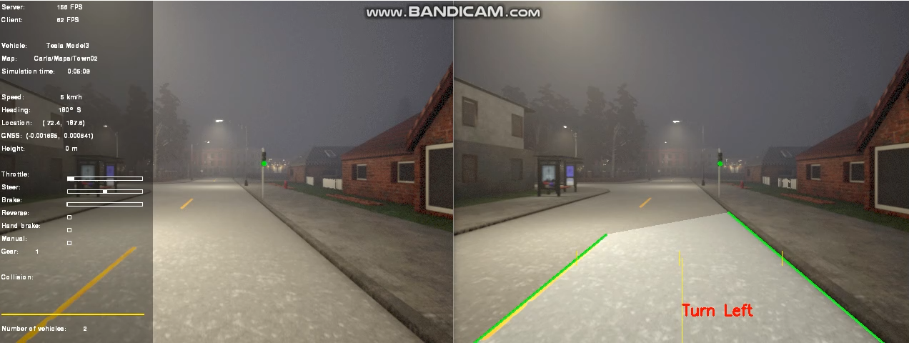
Traffic Light & Cloudy Evening

Slide 14
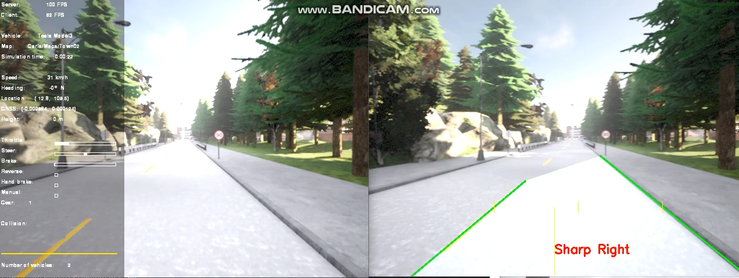
90 MPH & Clear Noon
Notes:
Signs of the video
Throttle control
Monday

Slide 15
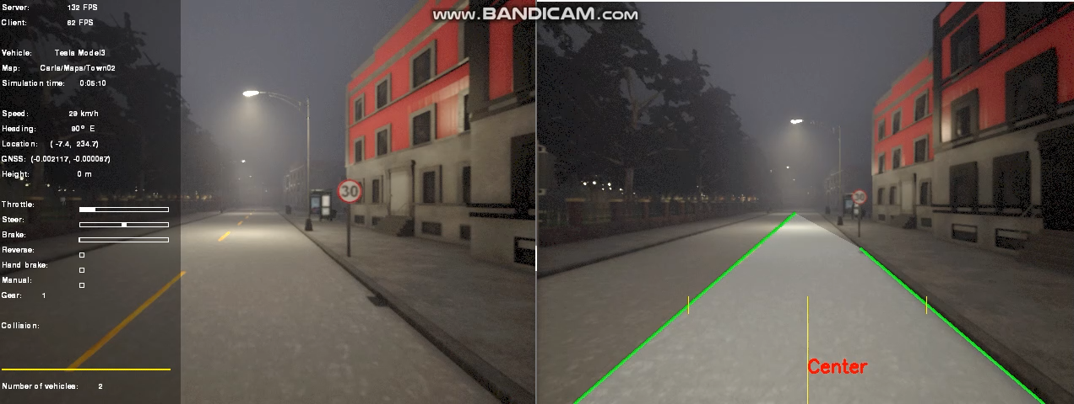
30 MPH & Cloudy Evening

Slide 16
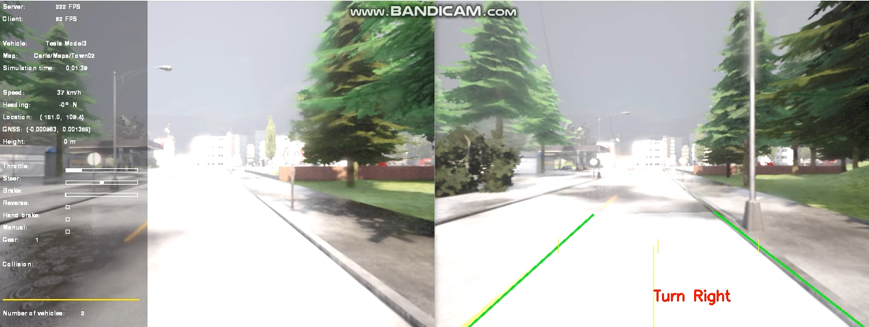
60 MPH & Mid Rainy Noon

Slide 17
Future work
Explore object detection method such as YOLO
1
Create my own map to customize my need
2
Explore machine learning methods such as deep learning methods
3
Routing system for interactions with no lanes
4
Evaluate how well comfort, travel time, safery
5
Notes:
R

Slide 18

Sources
https://carla.readthedocs.io/en/stable/carla_settings/
https://www.kaggle.com/datasets/amandam1/120-dog-breeds-breed-classification
http://scipy-lectures.org/packages/scikit-image/
https://scikit-learn.org/stable/modules/svm.html
https://scikit-learn.org/stable/modules/generated/sklearn.model_selection.GridSearchCV.html

Slide 19
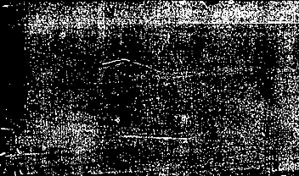

Questions

